Slide 1
The Bayeux Tapestry
“Walking” the Tapestry
Newberry Library Seminars
Susanne Dumbleton
June 24, 2021

Slide 2
History OF the Tapestry: “Little Short of Miraculous”
Probably completed 1077; probably displayed St. John’s Day, July 14
1077-1476, little known, but probably displayed annually. Probably stored in a cedar chest.
1476: Described for the first time (or at least in a document we have)
“A very long and narrow hanging of linen, embroidered with figures and inscriptions representing the conquest of England, which is hung around the nave of the church (cathedral) on Feast of Relics and throughout the Octave” (July 1-8).”
18th Century, still displayed once a year.
“Re-discovered” (for better and worse)
1724, two reproductions produced (in print books).
1792, narrow escape. During French Revolution, revolutionaries wanted to use it to cover a wagon). Administrator of Bayeux returned it to the cathedral, where it was confiscated and catalogued.

Slide 3
History OF the Tapestry “Little Short of Miraculous”
1803, Napoleon, thinking of invading England, had it brought to Paris, where he displayed at “Napoleon Museum” (now Louvre), Nov 1803-Feb 1804. Returned to Bayeux.
1840, put on list of historical monuments.
1842, moved to Bayeux library and librarians put in charge.
1913, moved to residence of dean of cathedral.
1941, Hitler had brought to Sarthe—likely to be brought to Berlin.
1944, August, following expulsion of German Army, exhibited at Louvre; returned to Bayeux.
1982-3 examined, then returned to new home, new museum.
2022-4 to be displayed in England under still-evolving arrangements.
New museum being planned.

Slide 4
January 2020 Review by 8 Restorers Medievalists.net
“Among their findings were that the tapestry has 24,204 stains, 16,445 wrinkles, 9,646 gaps in the cloth or the embroidery, 30 non-stabilized tears, and significant weakening in the first few metres of the work. Some of this damage took place long ago, such as nail holes from successive hangings or wax stains caused by candles used to light Bayeux Cathedral where it was originally displayed.
“The report will be used by conservation experts to make necessary repairs to the tapestry and prepare it for a new exhibition space when the museum is rebuilt in the mid-2020s.”

Slide 5
“King Edward, where Harold:” Condition of the tapestry ends. Care / skill / decisions / restoration over the centuries.

Slide 6
“Here King Edward, in his bed, addresses his faithful followers,” “and here he died.” Plot and Character and tone. Note Edward’s hand and Harold’s hand. Is this the “Dying Voice,” appointing Harold as next king? Clearly grief Emotion and change. For ”plot, note that order seems transposed—probably for convenience? Possible design complication?

Slide 7
Scene 28: “Here King Edward speaks to his followers from bed.” Emotion and character and mood differentiation. For plot, note that Edward may be giving Harold “the dying voice.”

Slide 8
Scene 28: “And here he dies.” Emotion evident in facial expressions. Maybe even in roughness (e.g. bishop’s left hand.) Power in the simplicity, especially given the upstairs/downstairs depiction. Power of the words: “defunctus est.”

Slide 9
Now to Walk the Tapestry

Slide 10
Military Considerations

Slide 11
“France was a configuration of dukedoms, and William, as head of Normandy, was successful at securing support. Fighting with him were troops from Brittany and Flanders. Some historians describe the battle as having three flanks, parallel to this map

Slide 12
Military Movements Sept-Oct 1066 William (Red) Sept 12, leaves Dives-sur-Mer for Ponthieu; Sept 28, leaves Ponthieu for Pevensey. Harold (Green) Sept 15, heads north; Sept 25, fights major battle; Sept ? Heads south; October 14, engages in battle at Hastings Negotiations apparently went on between the two men, but failed.

Slide 13
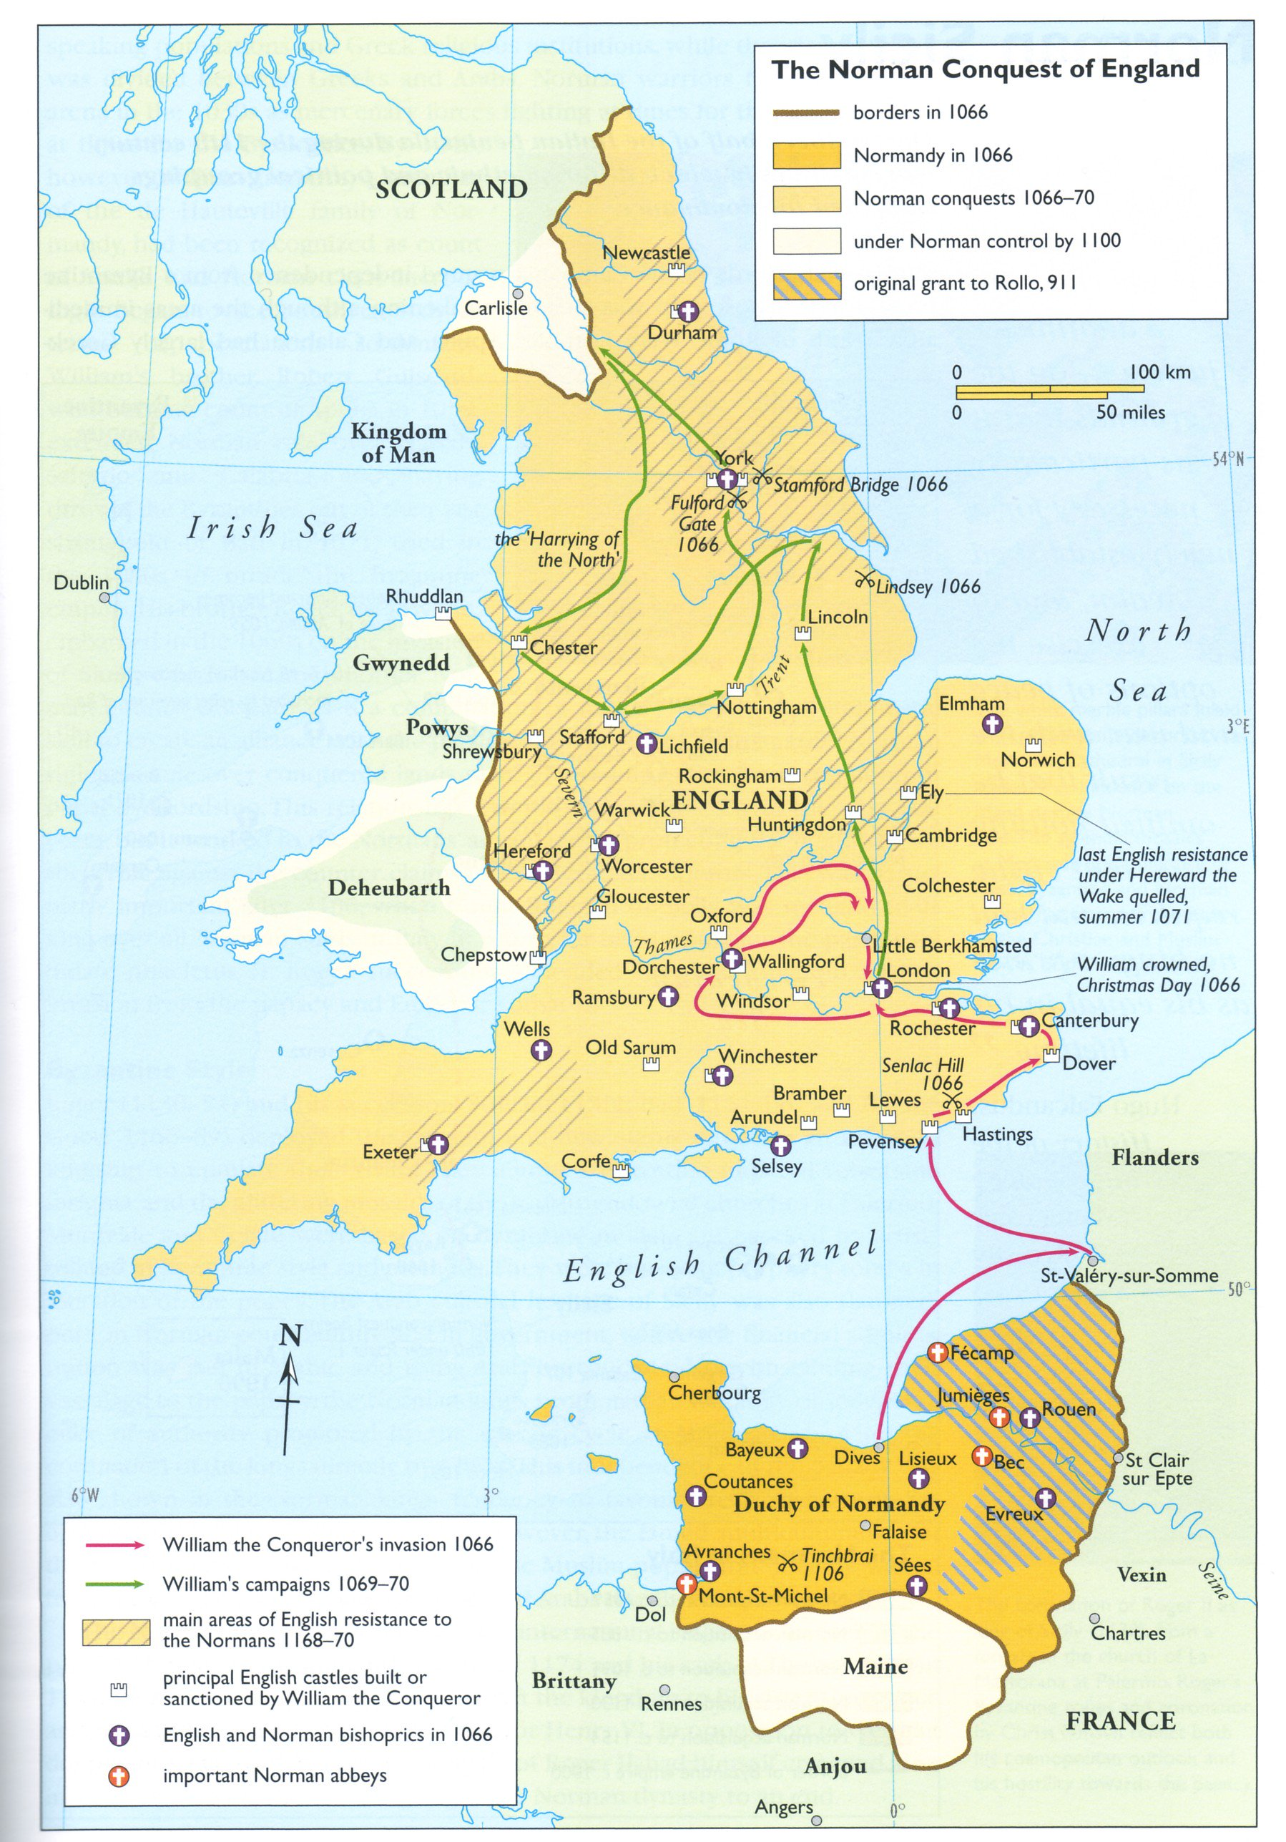

Slide 14
For more details of the military strategy and encounter, see also the video linked to the webpage.

