Slide 1
Fair Play
Modern Heroes in the Fight for Human Rights
Susanne Dumbleton
Newberry Library Spring 2017

Slide 2
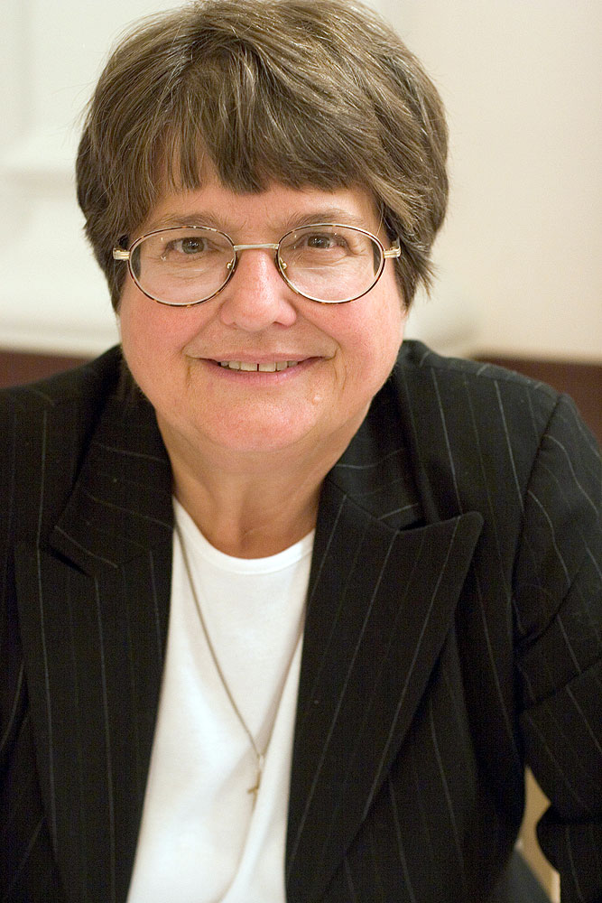
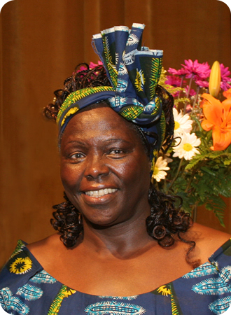
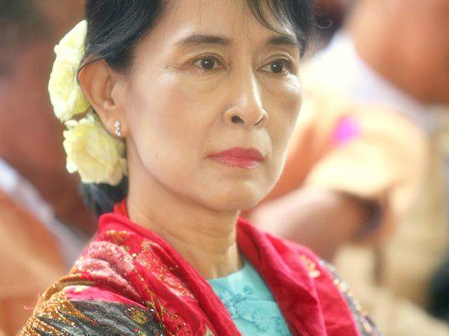
Fair Play: Modern Heroes in the Fight for Human Rights
Helen Prejean
Wangari Maathai
Aung San Suu Kyi
Notes:
My understanding of Vincent’’s life and work is that it began with empathy--the ability to stand beside the persons he met, rather than back from, or above, or below. He did not objectify them or intellectualize their problems. As he sought to ease their pain, he did so in full awareness of their individual being. What I have learned in studying these three women is that they are Vincentian in that way.

Slide 3
Part I
The Protagonists

Slide 4
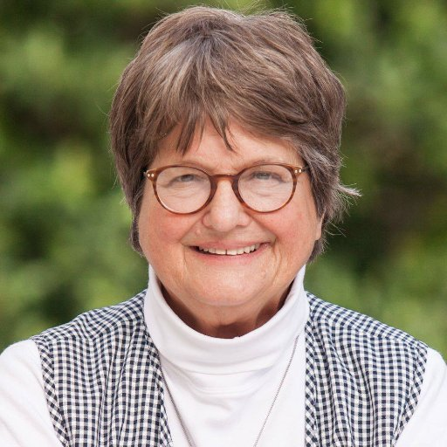
Helen Prejean
Spiritual Advisor to Death Row Inmates
Criminal Justice System Reformer
Social Justice Activist
Author, Speaker
Anti-Death Penalty Leader

Slide 5
Sister Helen Prejean as Spiritual Advisor accompnyi Robert Willie at Pardon Board Hearing
1984

Slide 6
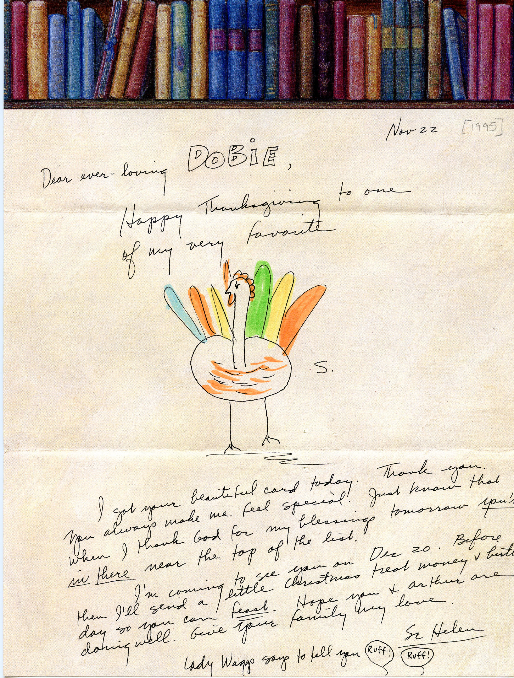
Sister Helen as Spiritual Advisor
One of over 300 Letters to Dobie Gillis Williams

Slide 7
Sister Helen Prejean as advisor to families of prisoners as well as victims
TBA

Slide 8
Sister Helen as public intellectual.

Slide 9
Rationale: “I see their faces.”
Sister Helen Prejean, CSJ
Interview, 2012

Slide 10
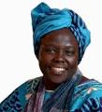
Wangari Maathai
Scientist, Political Activist
Founder of Green Belt Movement
Writer
Nobel Peace Prize Laureate, 2004
(For seeing link between Human Rights,
Sustainable Treatment of the Environment,
and Peace)

Slide 11
Wangari Winning the Nobel Peace Prize
The link between human rights, cultures of peace, and environmental rights :

Slide 12
“We are very fond of blaming the poor for destroying the environment. But often it is the powerful, including governments, that are responsible.”
Wangari Maathai
2010

Slide 13
Wangari with children creating a green belt

Slide 14
Wangari Maathai founding the Green Belt Movement 1974

Slide 15
“Human Rights are not things that are put on the table for people to enjoy. These are things you fight for and then you protect.
Wangari Maathai

Slide 16
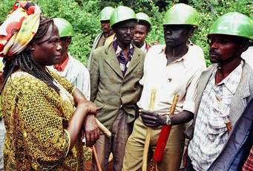

Slide 17
Rationale: “I don’t really know why I care so much. I just have something inside me that tells me that there is a problem and I have to do something about it. I think that is what I would call the God in me.”
Wangari Maathai

Slide 18
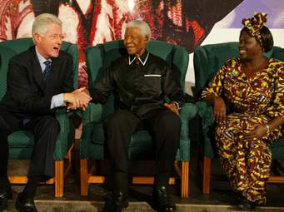

Slide 19
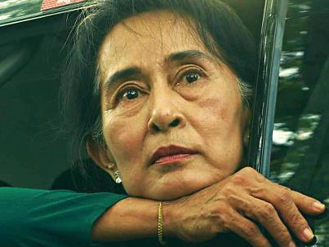
Aung San Suu Kyi
Dissident / Human Rights Activist for Burmese People
Political Prisoner 1989-2010
Writer
Nobel Peace Prize Laurate 1991
State Counselor (2016-Present)—Effective Head of State

Slide 20
Aung San Suu Kyi Released from House Arrest, October 2010

Slide 21
“Go to the movies if you want a hero; courage is a daily task.”
Aung San Suu Kyi
Speaking with supporters on being released from 15 years house arrest,
November 2010

Slide 23
To live the full life, one must have the courage to bear the responsibility of the needs of others…. One must want to bear this responsibility.
Aung San Suu Kyi, Freedom from Fear
Quoted by son Alexander when receiving Nobel Peace Prize for her

Slide 24
Daw Suu Kyi Offering Trust to Military Leaders
These men had attempted to assassinate her three times; had held her captive for 15 years; and had killed, imprisoned, thousands of her friends loyal supporters and driven a million into exile

Slide 25
Rationale: “If I see there is something I should do in the name of justice or the name of love, then I will do it.”
Aung San Suu Kyi
The Voice of Hope, 1996

Slide 26
“There is no act of charity that is not accompanied by justice or that permits us to do more than we reasonably can.”
Vincent de Paul
Letter to Francois du Coudray, in Toul, 17 June 1640

Slide 27
Part II
Human Rights: What Are They and Where do they Come From?

Slide 28
FAIR PLAY AS HARD-WIRED
Dr. Frans de Waal: The Morality of Animals
https://www.youtube.com/watch?v=GcJxRqTs5nk

Slide 29
FAIR PLAY AS HARD WON
Recent Human History

Slide 30
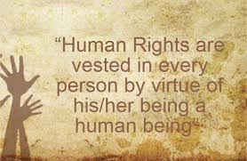

Slide 31
Declaration of Independence Second Continental Congress, July 4, 1776
We hold these truths to be self-evident, that all men are created equal, that they are endowed by their Creator with certain unalienable Rights, that among these are Life, Liberty and the pursuit of Happiness. –That to secure these rights, Governments are instituted among Men, deriving their just powers from the consent of the governed.

Slide 32
Declaration of the Rights of Man National Assembly of France August 26, 1789
Men are born and remain free and equal in rights. Social distinctions may be founded only upon the general good….
(17 articles follow)

Slide 33
Bill of Rights (I-X) Adopted by States December 15, 1791

Slide 34
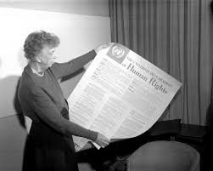
UNIVERSAL DECLARATION OF HUMAN RIGHTS DECEMBER 10, 1948

Slide 35
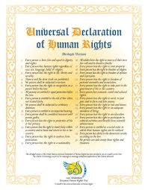

Slide 37
Why the Need for the fight? Power and Human Rights “Freedom from Fear”
Part III

Slide 38
Freedom From Fear
Interview with Aung San Suu Kyi on Fear and Freedom
https://www.youtube.com/watch?v=oa5PI00fHFk

